Slide 1
Synthetic Aperture Radar (SAR) Image Generation based on Generative Adversarial Network and Target Characteristics
Presenter: Ziyue Yang
杨子悦

Slide 2
Overview of Project
The aim of this project is to expand the dataset of SAR images (which is costly to acquire) via deep learning. The author intends to implement different types of GAN-based (Generative Adversarial Network) deep generative models, compares and contrasts the performances of these models when applying them to generate synthetic SAR images.
该项目的目标是通过深度学习扩展SAR图像的数据集（通常来说获取的费用较高）。作者打算实现不同类型的基于GAN（生成对抗网络）的深度生成模型，并比较和对比这些模型在应用于生成合成SAR图像时的性能表现。
Key Words: Deep Learning, GAN, Neural Network, Image Processing, Image Synthesis

Slide 3
What is SAR Image?
Synthetic Aperture Radar (SAR) image is a type of image that is created using radar technology. It works by emitting radio waves towards a target and measuring the reflection of those waves. The data collected is then processed to create an image that represents the target. SAR images have several unique properties, such as the ability to penetrate through clouds and the ability to see through objects, making them useful for applications such as mapping and remote sensing. In brief, a SAR image is a type of image that uses radar technology to see through objects and penetrate clouds.
合成孔径雷达（SAR）图像是使用雷达技术创建的一种图像类型。它通过向目标发射射频波并测量波的反射来工作。然后处理收集到的数据以创建代表目标的图像。 SAR图像具有几个独特的属性，例如穿透云层的能力和透视物体的能力，使它们在制图和遥感等应用方面非常有用。简而言之，SAR图像是一种利用雷达技术透视物体和穿透云层的图像类型。

Slide 4
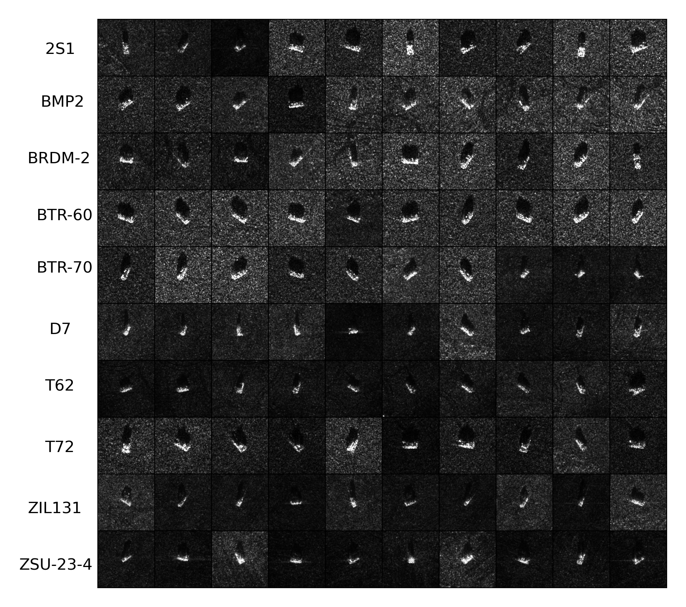
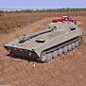
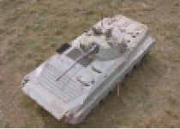
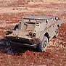
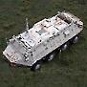
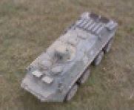
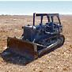
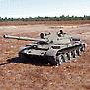
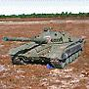
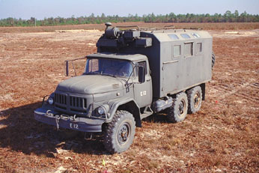
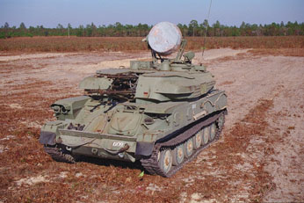
MSTAR Dataset

Slide 5
What is GAN?
Generative Adversarial Network (GAN) is a type of deep learning model that consists of two competing neural networks: a Generator and a Discriminator. The Generator creates new, synthetic data that is meant to resemble real data, while the Discriminator tries to determine which data is real and which is synthetic. These two networks are trained simultaneously, with the Generator trying to produce data that can fool the Discriminator, and the Discriminator trying to correctly identify the real data from the synthetic data. The end result is a Generator that can produce data that is similar in distribution to the real data.
生成对抗网络（GAN）是一种深度学习模型，由两个相互竞争的神经网络组成：生成器和判别器。生成器创建新的合成数据，旨在类似于真实数据，而判别器则试图确定哪些数据是真实的，哪些是合成的。这两个网络同时进行训练，生成器试图产生可以欺骗判别器的数据，而判别器试图正确识别真实数据和合成数据。最终结果是生成器可以生成与真实数据分布相似的数据。

Slide 6
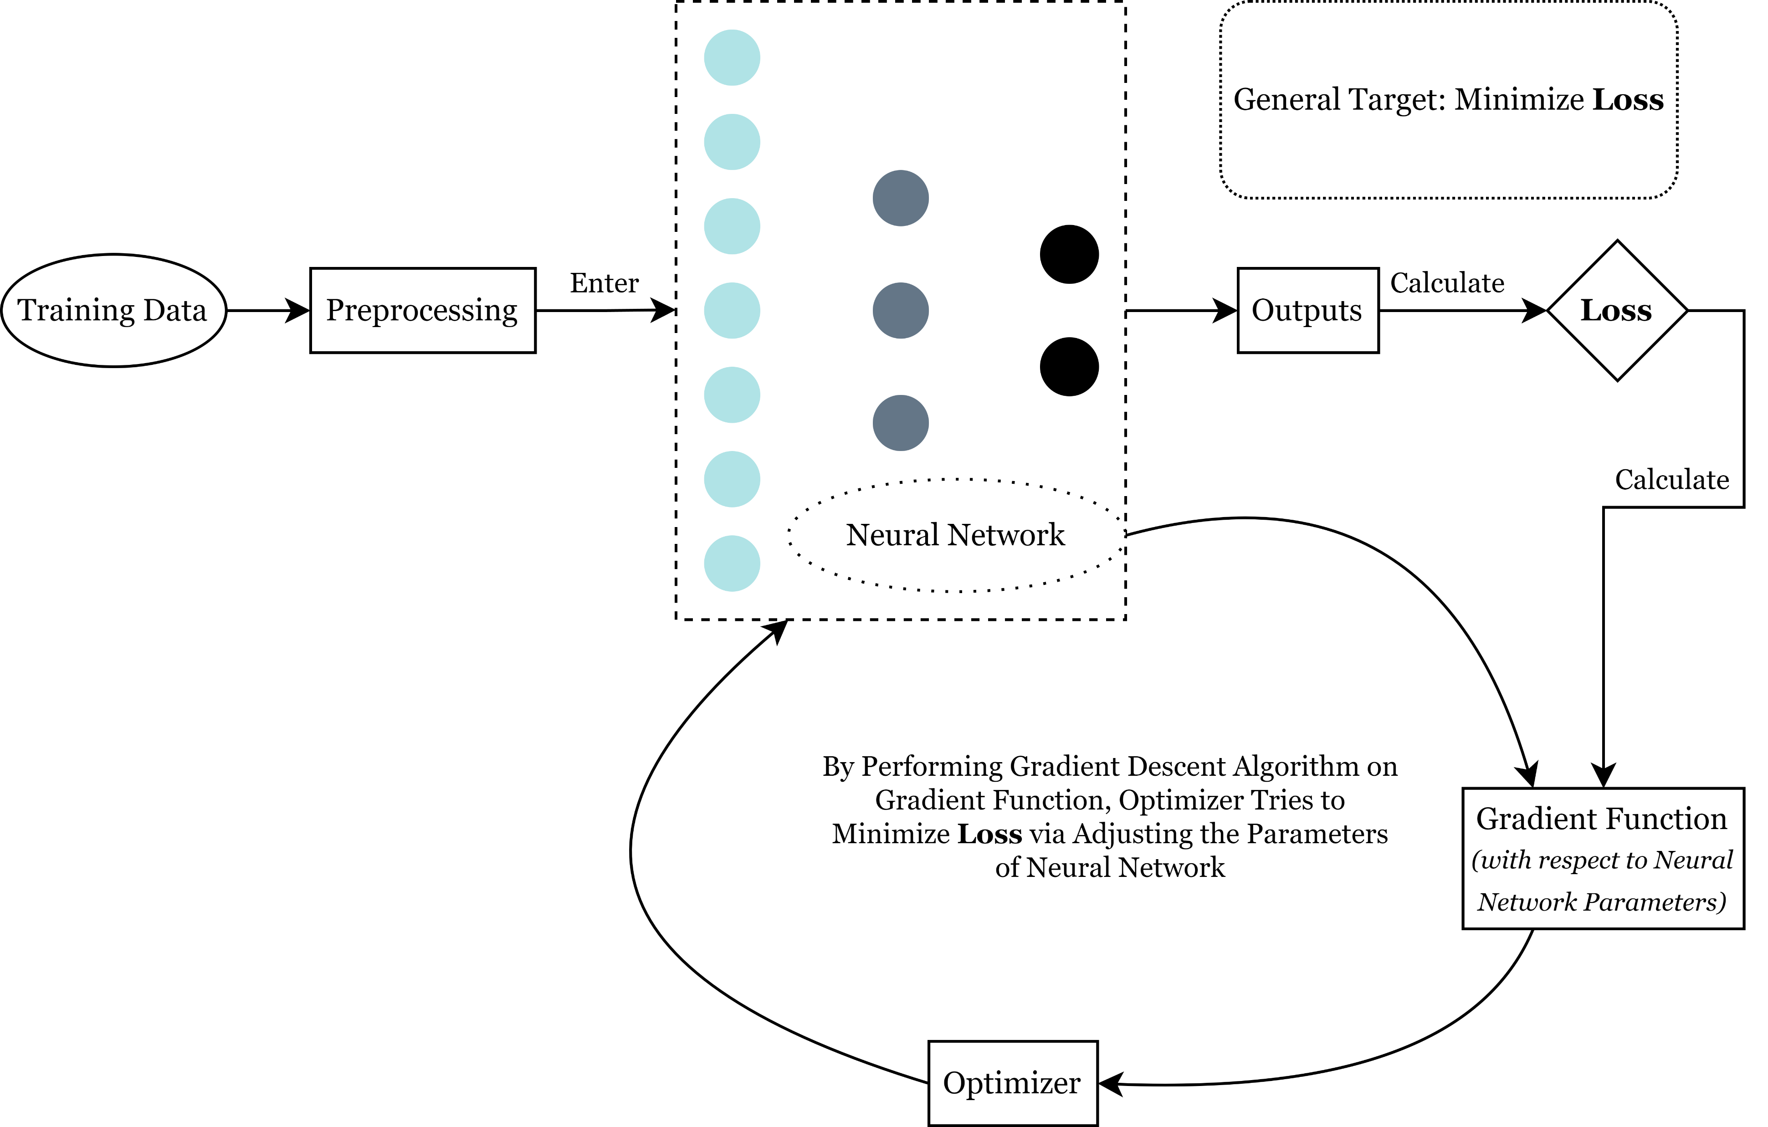
Standard Process of Training a Neural Network

Slide 7
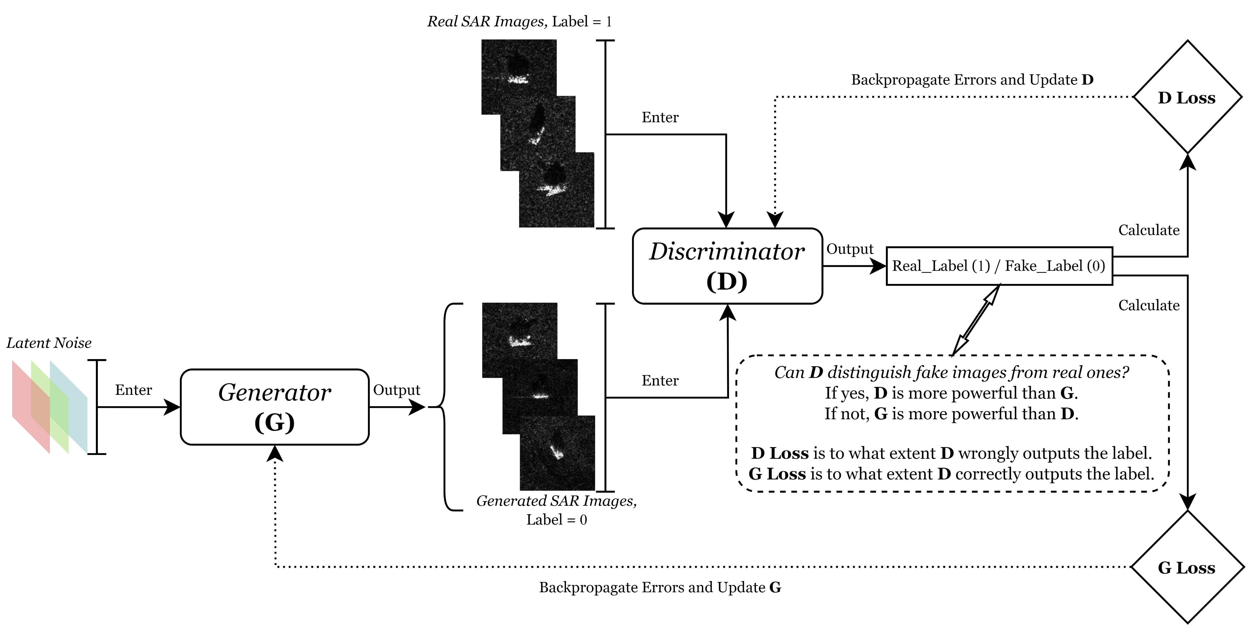
General Working Principle of a GAN

Slide 8
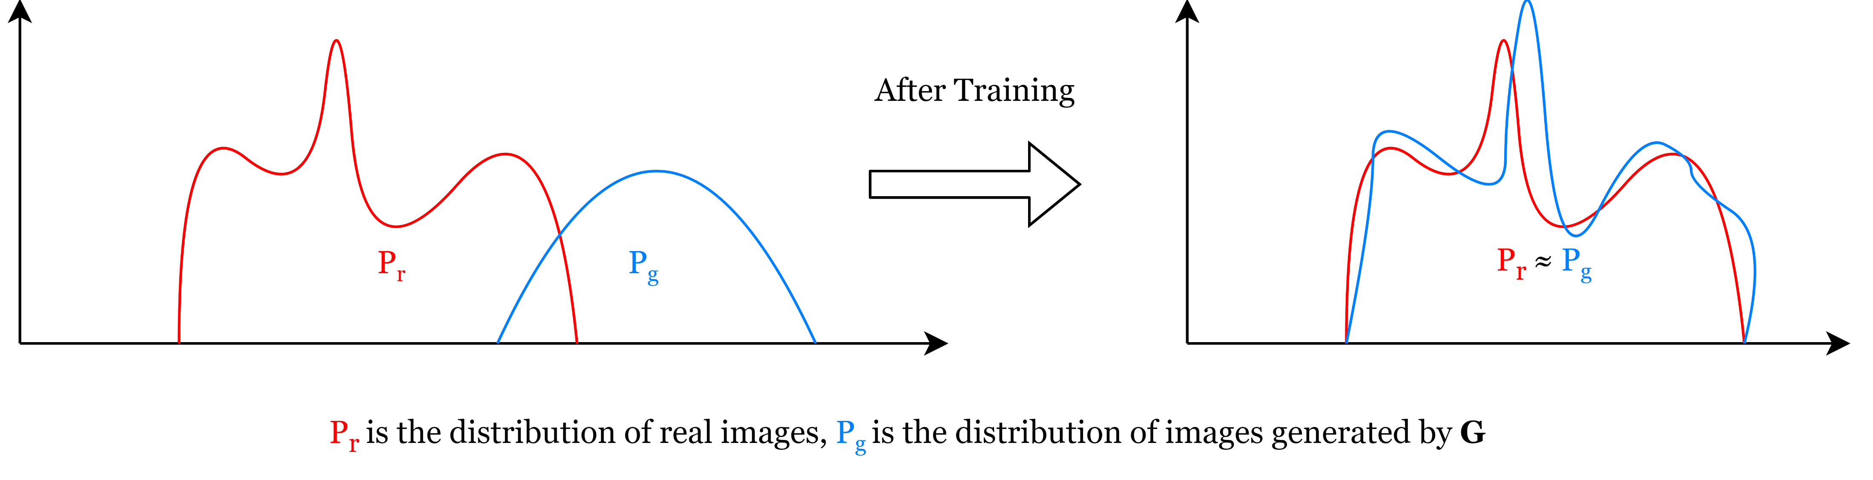
GAN’s Aim: Fit the Distribution of Training Data

Slide 9
Work Done so far

Slide 10
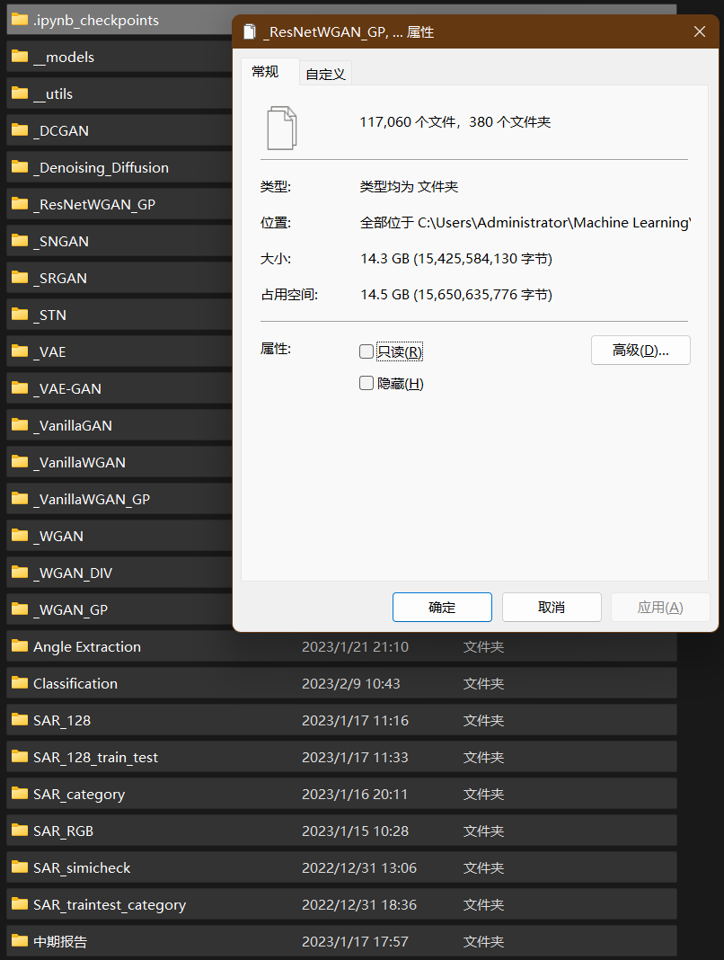
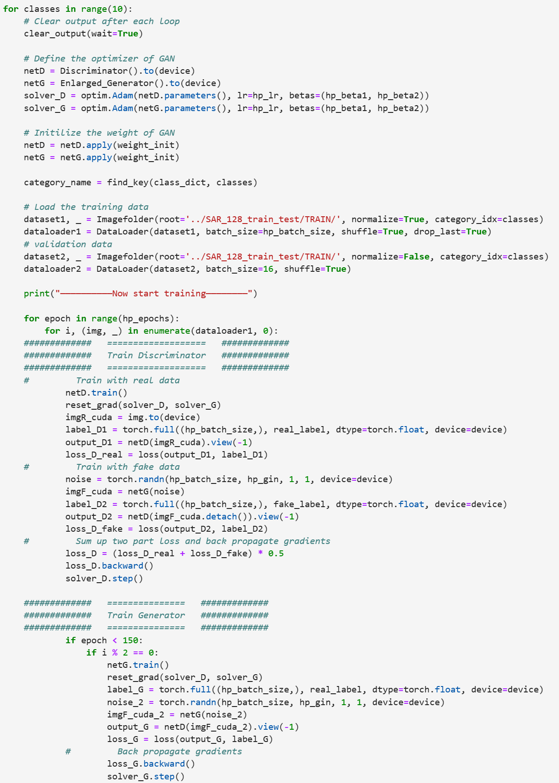
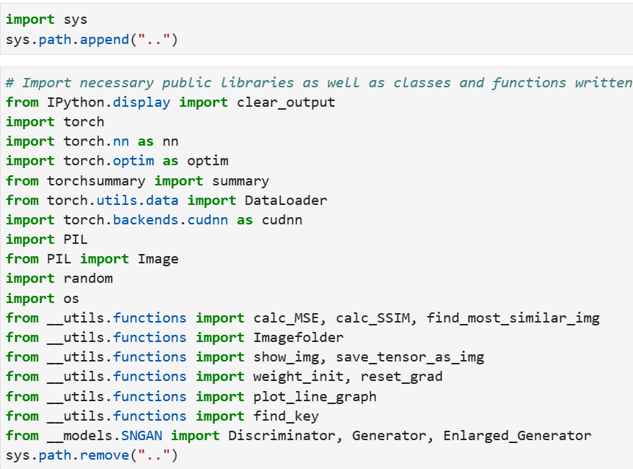

Slide 11
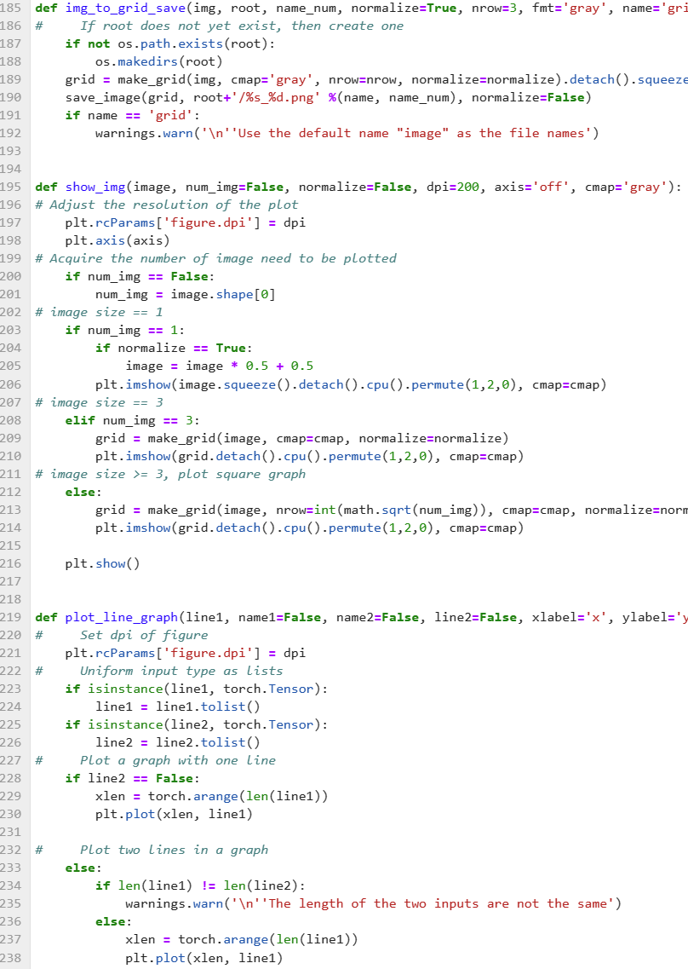
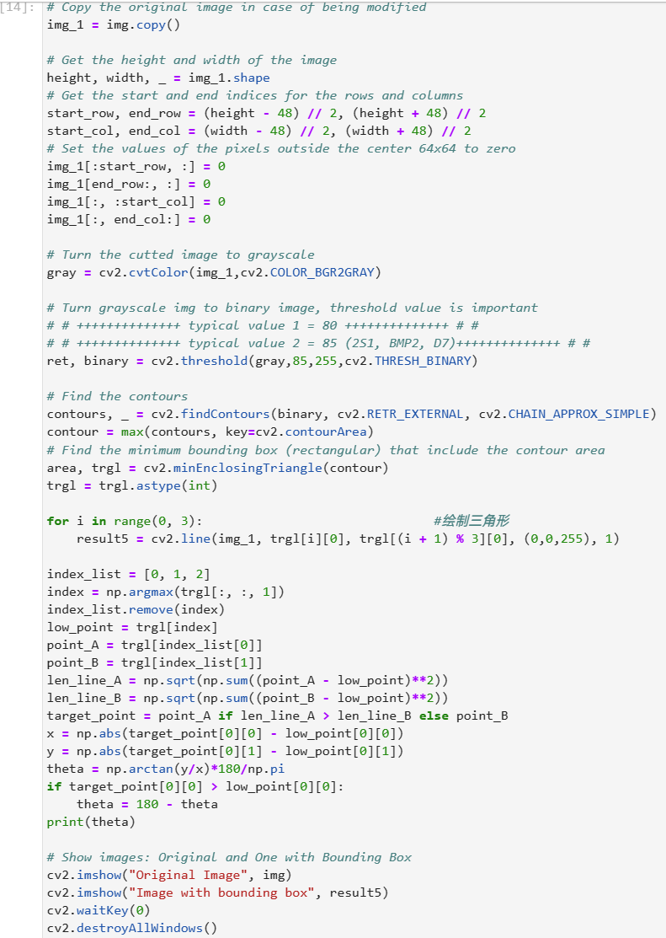
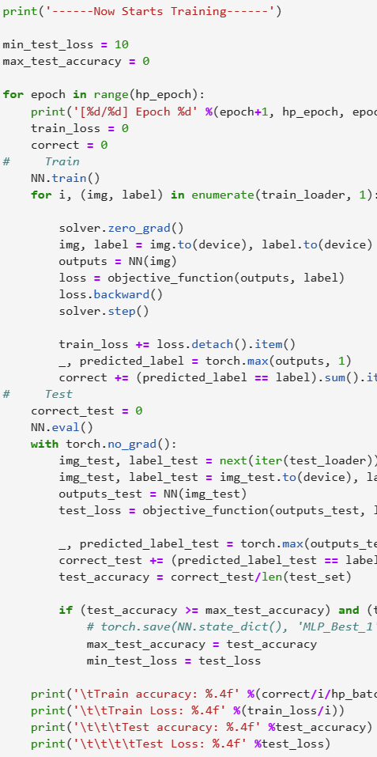

Slide 12
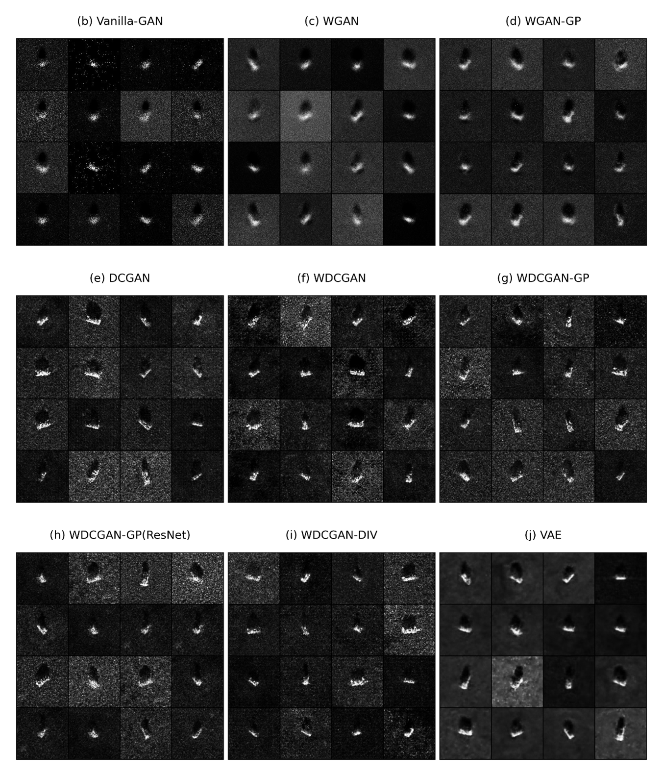
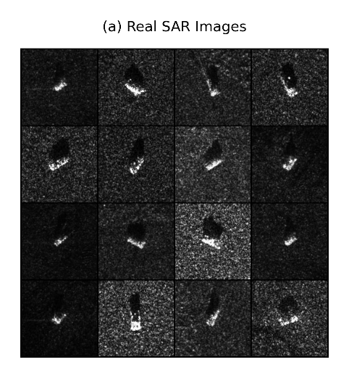
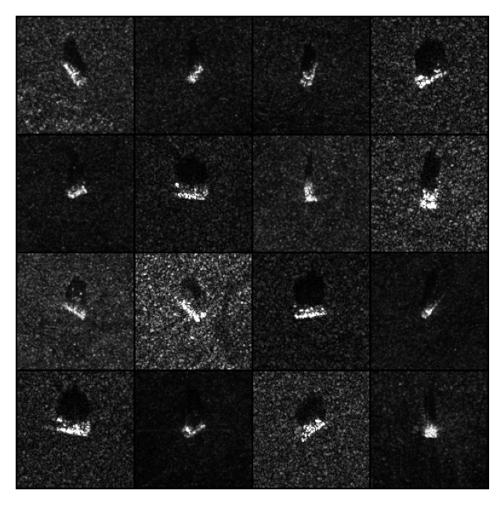
Models based on Multi-Layer Perceptron (MLP, also known as Fully-Connected Neural Network / Dense Layers)
Models based on Convolutional Neural Network (CNN)
(k) SNGAN

Slide 13
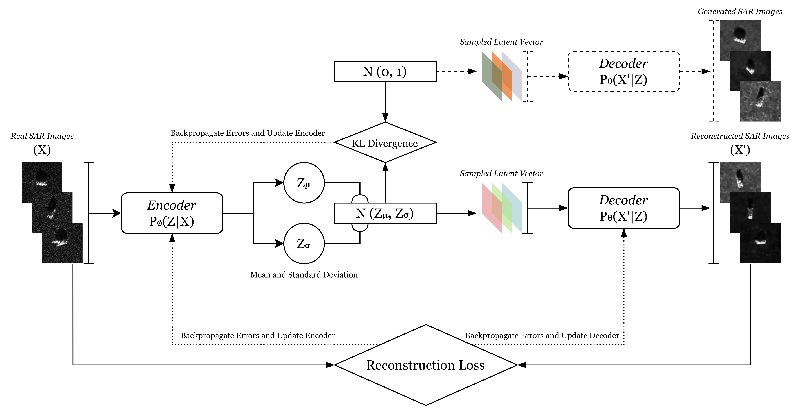

Slide 14
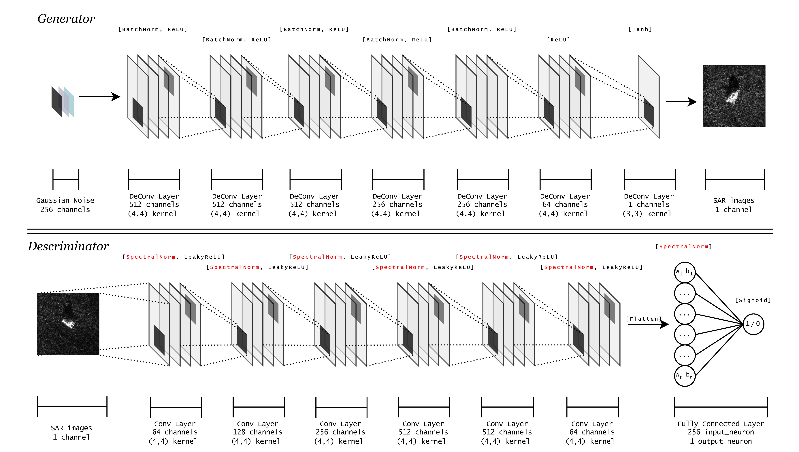
Example: Structure of SN(Spectral Normalized)-GAN

Slide 15
Difficulties in Project
Writing code is time consuming, but training models is even more costly.
Even a simple DCGAN model takes 8.33 sec to train for 1 epoch. The author usually train it for more than 300 epochs, which takes about 45 min.
It is a complicated task to train a GAN, why?
GAN is not a probabilistic model (typical probabilistic generative models: Diffusion Models, VAE)
“Trade-Off” is important in Adversarial Training
Difficult to indicate whether GAN is getting better during training (The changes in the value of the loss function cannot be used as a strong reference)
Two frequent issues: Vanishing Gradient and Mode Collapse

Slide 16
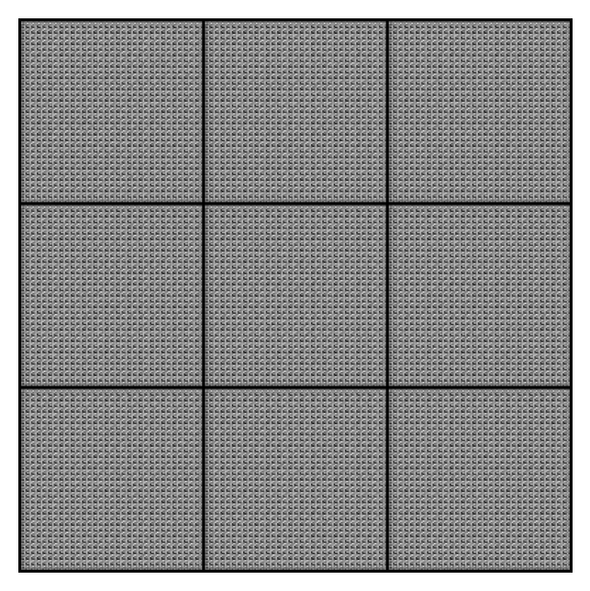
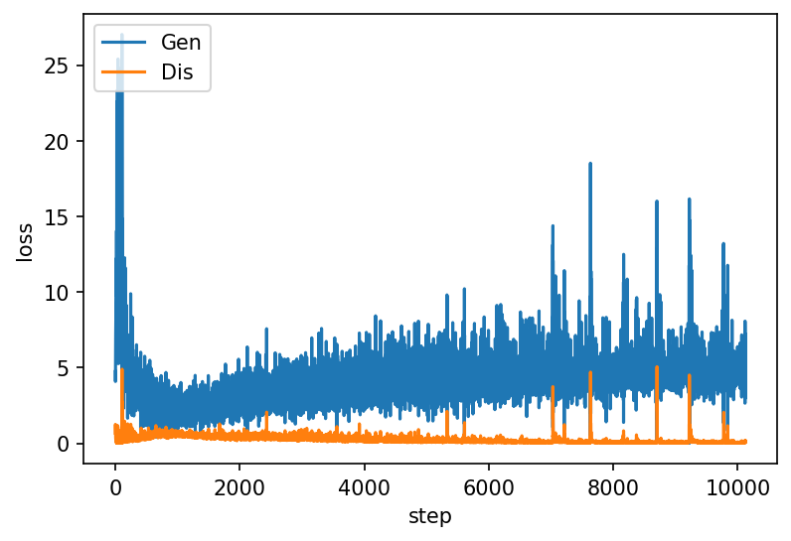
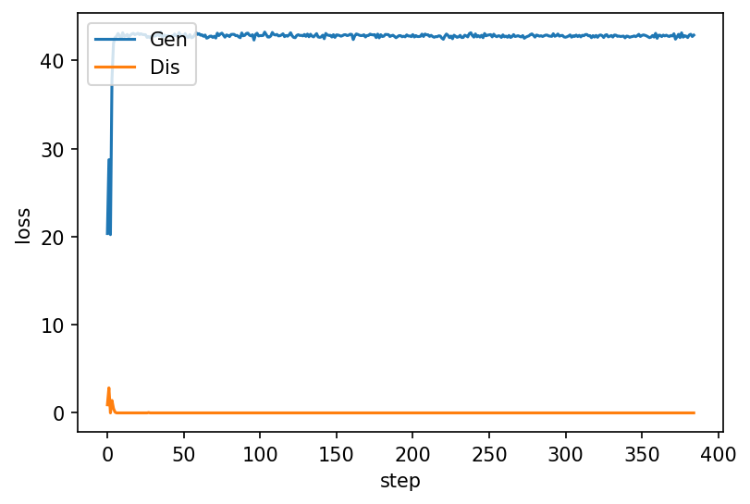
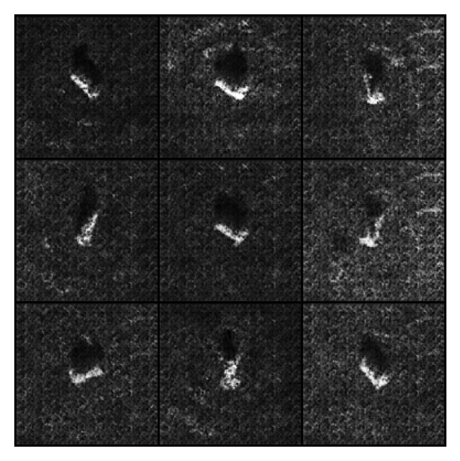
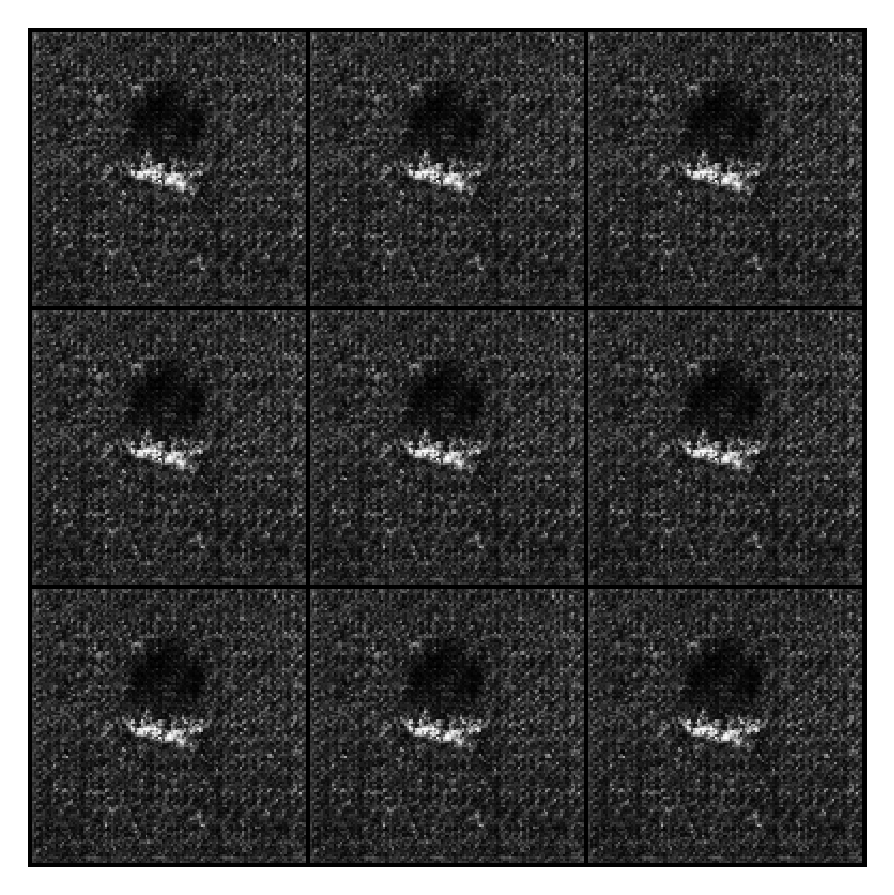
Vanishing Gradient
Mode Collapse

Slide 17
Plan of Future Work
Evaluate the performance of different models via classification
Fine-tune the models to achieve better performance
If time permits:
Train a machine learning model that can extract the generated SAR images with high quality and eliminate others
Use algorithms to extract generated SAR images with certain angle

